Slide 1
Objectives
In this session, you will learn to:
  Understand the principles and concepts of accounting
  Understand the double entry system of accounting
  Understand financial statements
Notes:
Share the session objectives with the students.

Slide 2
Understanding the Principles and Concepts of Accounting
Accounting is a process of identifying, recording, summarising and reporting economic information to decision makers in the form of financial statements.
Financial statements are useful to the following parties:
  Suppliers
  Customers
  Employees
  Banks
  Suppliers of equipments, buildings and other assets
  Lenders
  Owners

Slide 3
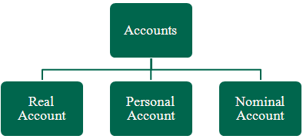
Understanding the Principles and Concepts of Accounting (Contd.)
Type of Accounts:
  The following figure represents the various types of accounts maintained for transactions.

Slide 4
Understanding the Principles and Concepts of Accounting (Contd.)
Accounts can be broadly classified under the following groups:
  Assets
  Liabilities
  Income
  Expenses

Slide 5

Understanding the Principles and Concepts of Accounting (Contd.)
Golden Rules of Accounting:
  The following figure represents the golden rule of accounting.

Slide 6
Understanding the Principles and Concepts of Accounting (Contd.)
Accounting Principles, Concepts and Conventions:
  The following principles, concepts and conventions are developed to ensure that accounting information is presented accurately and consistently:
    Revenue Realisation
    Matching Concept
    Accrual
    Going Concern
    Accounting Period
    Accounting Entity
    Money Measurement

Slide 7
Understanding Double Entry System of Accounts
Double Entry System of Book Keeping:
  The following are the various features of double entry system of book keeping:
    Every business transaction affects two accounts.
    Each transaction has the following two aspects:
      Debit
      Credit
    It maintains a complete record of all business transactions.
    It helps to check the accuracy of the accounting transactions, by preparation of trial balance.
    It helps ascertaining profit earned or loss occurred during a period, by preparation of Profit & Loss Account.
    It helps ascertaining financial position of the concern at the end of each period, by preparation of Balance Sheet.
    It helps timely decision making based on sufficient information.
    It minimises the possibilities of fraud due to its systematic and scientific recording of business transactions.

Slide 8
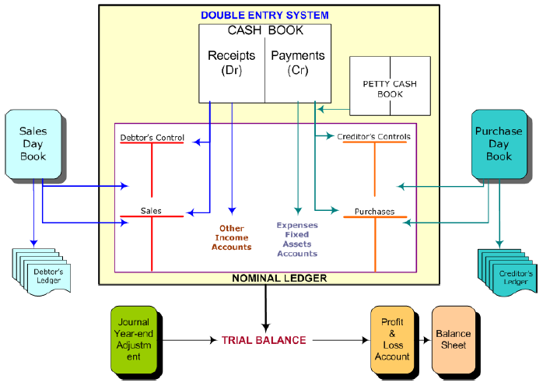
Understanding Double Entry System of Accounts (Contd.)
  The following figure represents the process of double entry system of book keeping.

Slide 9
Understanding Double Entry System of Accounts (Contd.)
Mode of Accounting:
  Accounting identifies only those transactions and events which involves money and is sorted on various source documents.
  The following are the commonly used source documents:
    Cash Memo
    Invoice or Bill
    Vouchers
    Receipt
    Debit Note
    Credit Note

Slide 10
Understanding Double Entry System of Accounts (Contd.)
Voucher:
  It is a document in support of a business transaction, containing the details of such transaction.
Receipt:
  When a trader receives cash from a customer against goods sold by him, the trader issues a document to the customer. This document is referred as receipt. It contains the following details:
    Name of the customer
    Details of amount received
    Date on which amount is received

Slide 11
Understanding Double Entry System of Accounts (Contd.)
Invoice or Bill:
  When a trader sells goods to a buyer, the trader prepares a sales invoice containing the details such as name and address of buyer, name of goods, amount and terms of payments.
  When a trader purchases goods on credit, receives a invoice/bill from the supplier of such goods.
Journal:
  It is a record in which all business transactions are entered in a chronological order.
  A record of single business transaction is called a journal entry and is supported by a voucher.

Slide 12
Understanding Double Entry System of Accounts (Contd.)
Account:
  It is a statement of transactions affecting any particular asset, liability, expense or income.
Ledger:
  It is a book which contains all the accounts whether personal, real or nominal, which are entered in journal or subsidiary books.
Chart of Accounts:
  It is a list of all accounts used by an organisation, displaying the categorisation and grouping of its accounts.

Slide 13
Understanding Double Entry System of Accounts (Contd.)
Posting:
  It is the process of transferring the entries recorded in the journal or subsidiary books to the respective accounts opened in the ledger.
Trial Balance:
  It is a statement which shows debit balances and credit balances of all Ledger accounts.
  A detailed trial balance has columns for:
    Account name
    Debit balance
    Credit balance

Slide 14
Understanding Financial Statements
Financial Statements:
  Are final result of accounting work done during the accounting period.
  Serve a significant purpose to users of accounting information in knowing about the profitability and financial position of the organisation.
  Include the following documents:
    Trading Account
    Profit and Loss Account
    Balance Sheet

Slide 15
Understanding Financial Statements (Contd.)
Trading Account:
  It refers to buying and selling of goods.
  It displays the transactions pertaining to buying and selling of goods.
  The difference between the two sides of the trading account either displays gross profit or gross loss.

Slide 16

Understanding Financial Statements (Contd.)
Under which conditions, trading account represents Gross Profit?

Slide 17

Understanding Financial Statements (Contd.)
If the credit side total is in excess of the debit side total, the difference represents Gross Profit.

Slide 18
Understanding Financial Statements (Contd.)
Under which conditions, trading account represents Gross Loss?

Slide 19
Understanding Financial Statements (Contd.)
If the debit side total is in excess of the credit side total, the difference represents Gross Loss.

Slide 20
Understanding Financial Statements (Contd.)
Profit and Loss Account:
  It shows the performance of the company in terms of profits or losses over a specified period.
  The Net Profit is expressed by using the following formula:
    Net Profit = (Gross Profit + Other Income) – (Selling and
    Administrative Expenses + Depreciation +
    Interest + Taxes + Other Expenses)

Slide 21
Understanding Financial Statements (Contd.)
Balance Sheet:
  It is a statement that summarises the assets and liabilities of a business.
  It provides the following information of a company:
    Long-term financial strength
    Efficient day-to-day working capital management
    Asset portfolio
    Sustainable long-term performance

Slide 22
Understanding Financial Statements (Contd.)
Transactions:
  A transaction is a financial event that takes places in the course or furtherance of business and effects the financial position of the company.
  It can be classified into following categories:
    Receipts – cash or bank
    Payments – cash or bank
    Purchases
    Sales

Slide 23
Understanding Financial Statements (Contd.)
Recording Transactions:
  Transactions should be recorded promptly and correctly to ascertain the financial statement of a company as on a particular date.
  The business transactions are of following nature:
    Purchase of goods either as raw materials for processing or as finished goods for resale
    Payment of expenses incurred towards business
    Sale of goods or services
    Receipts (in Cash or by Cheques)
    Payments (in Cash or Cheques)

Slide 24
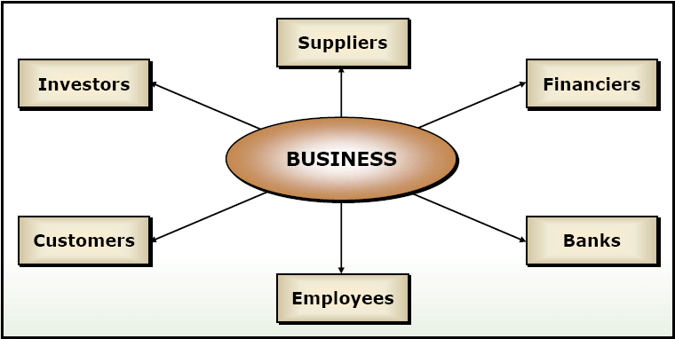
Understanding Financial Statements (Contd.)
The following figure shows the parties dealt within a business process.

Slide 25
Summary
In this session, you learnt that:
  Accounting is a comprehensive system to collect, analyse and communicate financial information.
  Double Entry accounting is a system of recording transactions in a way that maintains the equality of the accounting equation.
  The three types of accounts maintained for transactions are real accounts, personal accounts and nominal accounts.
  Entity is the organisational unit for which accounting records are maintained.
  Journal entry is a record of a single business transaction.
  Voucher is a document evidencing the details of a financial transaction.

Slide 26
Summary (Contd.)
  Ledger is a book in which accounts are maintained.
  Trial balance is a list of the balances of all the ledger accounts.
  Profit and loss statement shows the performance of the company in terms of profits or losses made by it over a specified period.
  Balance sheet gives an overview of the financial position of a company as on a specific date.

